Slide 1
Author Mappings for PSIS Query 2008a
Tony Davey
tony.davey@nhs.net
Comms and Messaging
July 2007
Version 1.3

Slide 2
PSIS Query 2008
4 main query / responses.
Query requests use name/value parameters.
Query responses contain metadata partly extracted from Documents.
Queries/responses are messages that contain metadata about a Document.
One query response also contains a Document Payload.
Metadata is intended to populate local system displays, lists, for filtering, etc.

Slide 3
PSIS Queries
All queries are used in pairs:
  Queries (requests),
  Query responses.
All queries consist of 2 parts:
  Control act,
  Message payload.
PSIS Query RMIMs only illustrate the payload.

Slide 4
Control Acts in Query / Responses
Specified in Infrastructure domain.
Standardised across MIM for all types of queries, e.g. LRs, PDS, PSIS Query.
HL7 compliant.
Contain 1..3 types of authors:
  Initiating system with ASID(1..1)
  Workstation with local ID (0..1)
  Person associated with query (0..1)
Same ‘author’ structure in query and response.

Slide 5
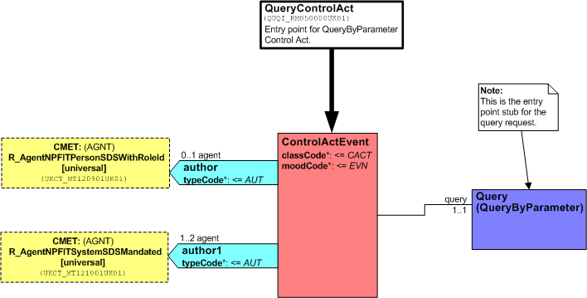
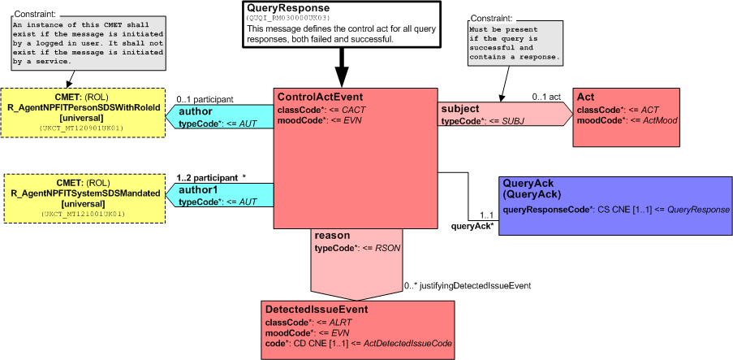
Control Act Author – Request and Responses
*Control act RMIMs from Infrastructure domain.
For query requests
For query responses

Slide 6
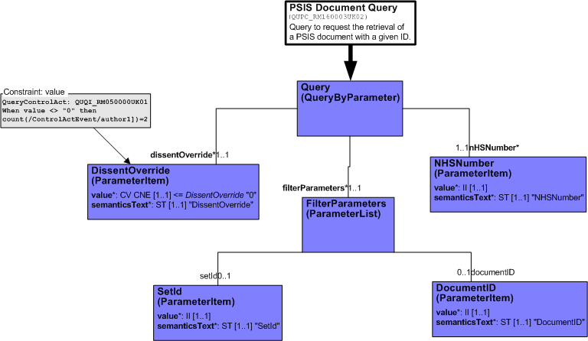
PSIS Query – Requests
Authors only present in control act to identify requesting system / person details.

Slide 7
PSIS Query - Responses
2..4 possible different authors:
  1..3 authors in query response control act.
  1 author in PSIS-Query message payload response metadata:
    at Document (header) level.

Slide 8
Authors in Query Response Control Act

Slide 9
Authors in Message Payload Response
  1 author in PSIS-Query payload response
    Document (Header) 1..1
      Always present in message payloads.
    Versions of MIM 6 prior to MIM 6.3 contained other authors, i.e. Section or sealing authors. These are no longer included for PSIS Query responses.

Slide 10
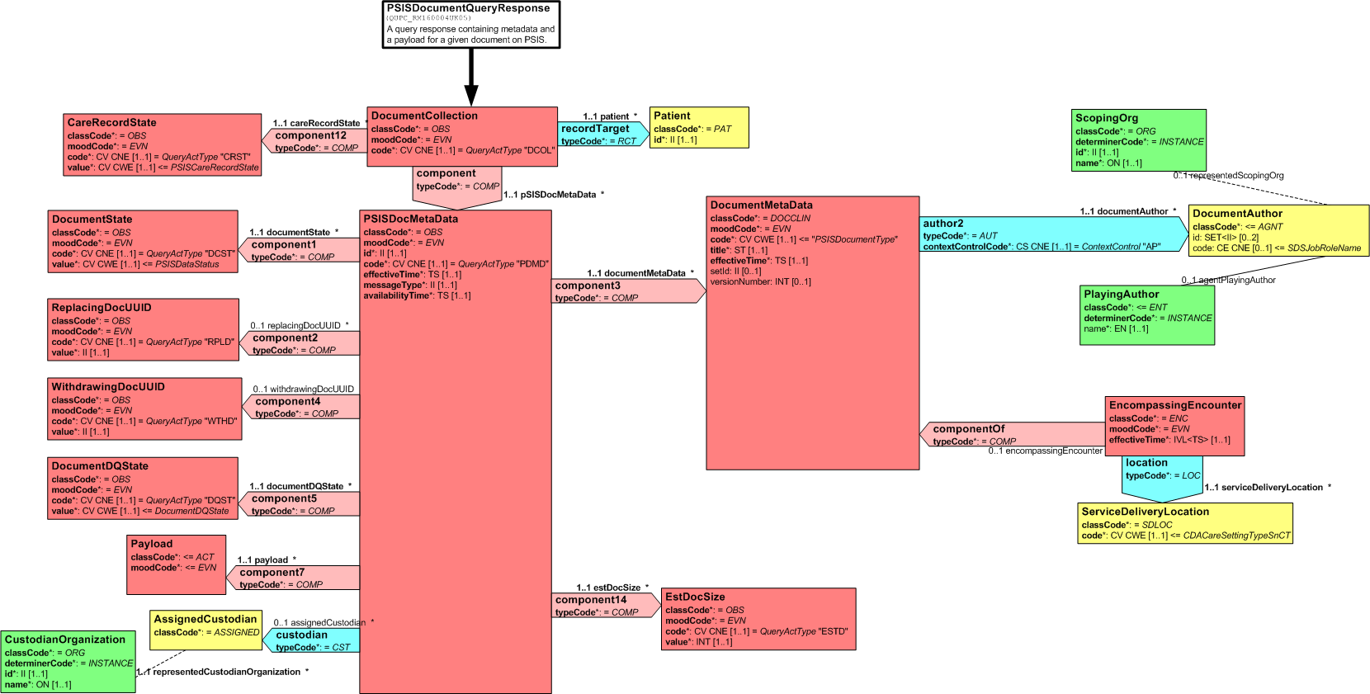
PSIS-Query Response D-MIM

Slide 11
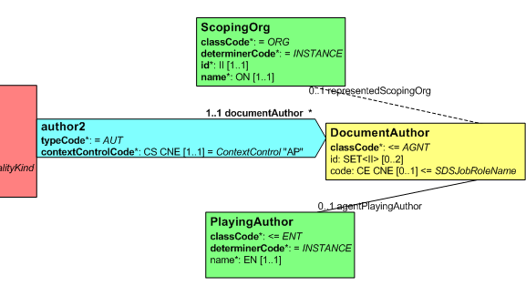
Author – Document level
Scoper – represented by dotted line.
Player – represented by solid line.

Slide 12
Players and Scopers
Always relate to a role:
  i.e. an employee in a company, NOT a specific person.
What is a player?
  The entity (usually a person) ‘doing’ the act.
    E.g. an employee in a company
What is a scoper?
  The entity (usually an organisation) who the player is acting in the scope of.
    E.g. an organisation employing the player (person)
Can sometimes have either a player OR a scoper.
PSIS role information ALWAYS relates to player, e.g IDs (However not for GP Summaries).

Slide 13
Author – Document level
Loose structure which allows for any existing author shape to be inserted.
Contains a subset of original Document author information – intended for population of lists.
Allows some degree of future changes without necessarily changing PSIS Query structure.
Playing and scoping entities are optional, to be populated as used in original document.

Slide 14
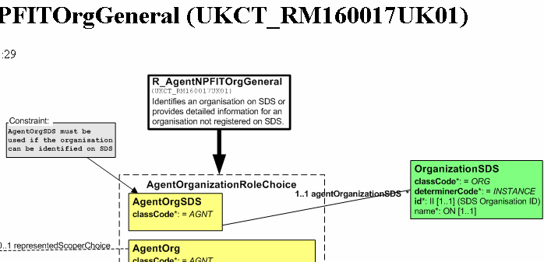
Initial GP Summary
Organisation is a PLAYER
GP Summary player IDs map
to Role on PSIS Author
No SCOPING entity
No Code attribute
Initial GP Summary
PSIS Query

Slide 15
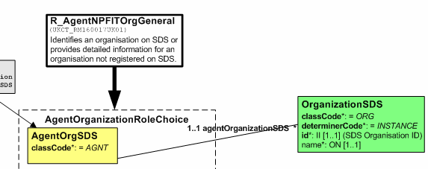
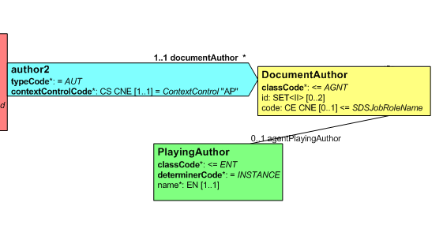
Initial GP Summary - Example
Initial GP Summary XML
<author typeCode="AUT" contextControlCode="OP">
<time value="200703140100"/>
<UKCT_MT160017UK01.AgentOrgSDS classCode="AGNT">
<agentOrganizationSDS determinerCode="INSTANCE" classCode="ORG">
<id root="1.2.826.0.1285.0.1.10" extension="M85011"/>
<name>The Bridge Street Practice</name>
</agentOrganizationSDS>
</UKCT_MT160017UK01.AgentOrgSDS>
</author>
PSIS-Query XML
<author2 typeCode="AUT" contextControlCode="AP">
<documentAuthor classCode="AGNT">
<id root="1.2.826.0.1285.0.1.10" extension="M85011"/>
<agentPlayingAuthor classCode="ORG" determinerCode="INSTANCE">
<name>The Bridge Street Practice</name>
</agentPlayingAuthor>
</documentAuthor>
</author2>

Slide 16
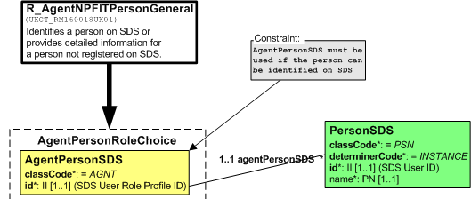
GP Summary
PersonSDS is a PLAYER
GP Summary player and role IDs map to Role on PSIS Author
No SCOPING entity
No Code attribute
GP Summary
PSIS Query

Slide 17

GP Summary - Example
GP Summary XML
<author typeCode="AUT" contextControlCode="OP">
<time value="200703140100"/>
<UKCT_MT160018UK01.AgentPersonSDS classCode="AGNT">
<id root="1.2.826.0.1285.0.2.0.67" extension="673836492727"/>
<agentPersonSDS determinerCode="INSTANCE" classCode="PSN">
<id root="1.2.826.0.1285.0.2.0.65" extension="984181387037"/>
<name>Dr Steve Jones</name>
</agentPersonSDS>
</UKCT_MT160018UK01.AgentPersonSDS>
</author>
PSIS-Query XML
<author2 typeCode="AUT" contextControlCode="AP">
<documentAuthor classCode="AGNT">
<id root="1.2.826.0.1285.0.2.0.65" extension="984181387037"/>
<id root="1.2.826.0.1285.0.2.0.67" extension="673836492727"/>
<agentPlayingAuthor classCode="PSN" determinerCode="INSTANCE">
<name>Dr Steve Jones</name>
</agentPlayingAuthor>
</documentAuthor>
</author2>

Slide 18
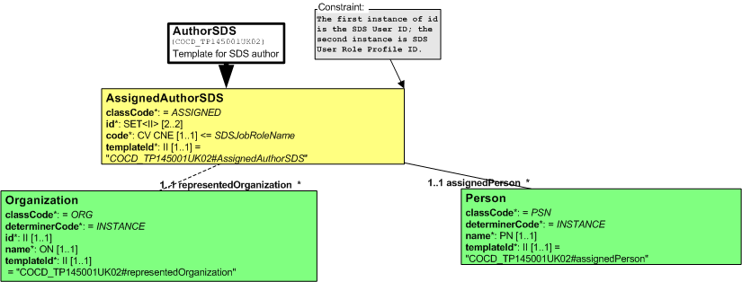



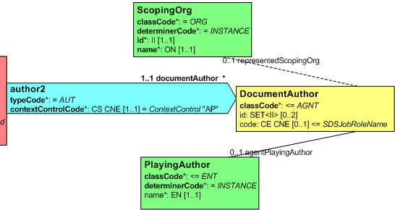
Clinicals – CDA - AuthorSDS
Person is a PLAYER
Org is a SCOPER
Role IDs and Code
All PSIS-Query author attributes are used
Clinical CDA Message
PSIS Query

Slide 19
CDA Clinicals - Example
CDA Clinicals XML
<author typeCode="AUT" contextControlCode="OP">
<npfitct:contentId root="2.16.840.1.113883.2.1.3.2.4.18.16" extension="COCD_TP145001UK02#AssignedAuthorSDS"/>
<functionCode displayName="Originating Author" codeSystem="2.16.840.1.113883.2.1.3.2.4.17.178" code="OA" codeSystemVersion="1.0"/>
<time value="200611011435"/>
<assignedAuthor classCode="ASSIGNED">
<templateId root="2.16.840.1.113883.2.1.3.2.4.18.2" extension="COCD_TP145001UK02#AssignedAuthorSDS"/>
<id root="1.2.826.0.1285.0.2.0.65" extension="754801085095"/>
<id root="1.2.826.0.1285.0.2.0.67" extension="507686339262"/>
<code code="R0110" codeSystem="2.16.840.1.113883.2.1.3.2.4.17.196" displayName="Specialist Registrar"/>
<assignedPerson classCode="PSN" determinerCode="INSTANCE">
<templateId root="2.16.840.1.113883.2.1.3.2.4.18.2" extension="COCD_TP145001UK02#assignedPerson"/>
<name>Fiona Feast</name>
</assignedPerson>
<representedOrganization classCode="ORG" determinerCode="INSTANCE">
<templateId root="2.16.840.1.113883.2.1.3.2.4.18.2" extension="COCD_TP145001UK02#representedOrganization"/>
<id root="2.16.840.1.113883.2.1.3.2.4.19.2" extension="300045332098"/>
<name>St. Elsewhere's Hospital</name>
</representedOrganization>
</assignedAuthor>
</author>
<author2 typeCode="AUT" contextControlCode="AP">
<documentAuthor classCode=" ASSIGNED">
<code code="R0110" codeSystem="2.16.840.1.113883.2.1.3.2.4.17.196" displayName="Specialist Registrar"/>
<id root="1.2.826.0.1285.0.2.0.65" extension="984181387037"/>
<id root="1.2.826.0.1285.0.2.0.67" extension="673836492727"/>
<agentPlayingAuthor classCode="PSN" determinerCode="INSTANCE">
<name>Fiona Feast</name>
</agentPlayingAuthor>
<representedScopingOrg classCode="ORG" determinerCode="INSTANCE">
<id root="2.16.840.1.113883.2.1.3.2.4.19.2" extension="300045332098"/>
<name>St. Elsewhere's Hospital</name>
</representedScopingOrg>
</documentAuthor>
</author2>
PSIS-Query XML

Slide 20
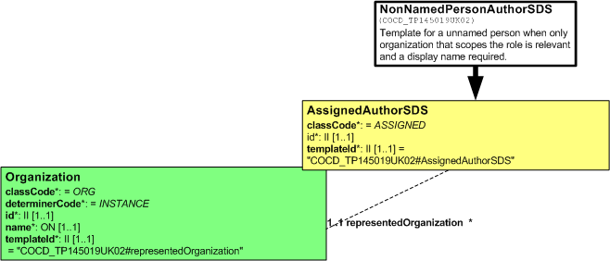
HealthSpace - CDA
No Playing Entity
Org is a SCOPER
In the role, both ID and Code are Null Flavours
HealthSpace CDA Message
PSIS Query

Slide 21
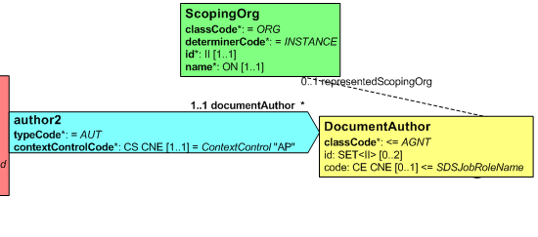
HealthSpace CDA - Example
HealthSpace CDA XML
<author contextControlCode="OP" typeCode="AUT">
<npfitct:contentId root="2.16.840.1.113883.2.1.3.2.4.18.16" extension="COCD_TP145019UK02#AssignedAuthorSDS"/>
<functionCode codeSystem="2.16.840.1.113883.2.1.3.2.4.17.178" code="OA" displayName="Originating Author" codeSystemVersion="1.0"/>
<time value="20061201124537"/>
<assignedAuthor classCode="ASSIGNED">
<templateId root="2.16.840.1.113883.2.1.3.2.4.18.2" extension="COCD_TP145019UK02#AssignedAuthorSDS"/>
<id nullFlavor="NA"/>
<representedOrganization determinerCode="INSTANCE" classCode="ORG">
<templateId root="2.16.840.1.113883.2.1.3.2.4.18.2" extension="COCD_TP145019UK02#representedOrganization"/>
<id root="2.16.840.1.113883.2.1.3.2.4.19.2" extension="YEL"/>
<name>HealthSpace</name>
</representedOrganization>
</assignedAuthor>
</author>
PSIS-Query XML
<author2 typeCode="AUT" contextControlCode="AP">
<documentAuthor classCode=" ASSIGNED">
<id nullFlavor="NA"/>
<representedScopingOrg classCode="ORG" determinerCode="INSTANCE">
<id root="2.16.840.1.113883.2.1.3.2.4.19.2" extension="YEL"/>
<name>HealthSpace</name>
</representedScopingOrg>
</documentAuthor>
</author2>

Slide 22
Questions?
To: tony.davey@nhs.net

